Slide 1
8255 PPI Programmable Peripheral Interface

Slide 2
Features of 8255A
The prominent features of 8255A are as follows −
It consists of 3 8-bit IO ports i.e. PA, PB, and PC.
Address/data bus must be externally demux'd.
It is TTL compatible.
It has improved DC driving capability.

Slide 3
Port A
There are various input output devices those are connected with computer system.
8086
8255 PPI
I/O Devices
Data bus
Keyboard
Muse
Monitor
Printer
Port B
All these devices are connected with computer through ports.
Port C
To handle all these devices or to handle all these ports a device required which is called as 8255 PPI
8255 is an intermediate between 8086 and all I/O devices. 8255 is connected with 8086 through data bus and all I/O devices are connected with 8255 through ports.
Why 8255 is required??
If there is no intermediate IC between 8086 and I/O devices still transfer can take place. But that transfer is unreliable.
8255 having 3 ports
Transfer using 8255
There is no permission signal in 8086, hence I/O devices can send the data directly to 8086 without permission. It may possible that 8086 is busy with other task like interrupt, bus request or other I/O device.
When any device wants to send data it will ask the permission to 8255.
1
2
8255 will give the permission and stored the data into its internal register.
In this situation I/O devices never gets the acknowledgement about the successful transfer of data. Hence the transfer is unreliable.
8255 informs to 8086 about transfer, when 8086 free it will read the data
3
To make transfer between 8086 and I/O devices reliable 8255 PPI IC is required.
4
If another device wants to send data to 8086 so it will ask to 8255 but 8255 will not grant the permission because still first transfer is not completed.
Data
8086
8255 PPI
I/O Devices
This entire process is called as handshaking

Slide 4
Ports of 8255A
8255A has three ports, i.e., PORT A, PORT B, and PORT C.
Port A contains one 8-bit output latch/buffer and one 8-bit input buffer.
Port B is similar to PORT A.
Port C can be split into two parts, i.e. PORT C lower (PC0-PC3) and PORT C upper (PC7-PC4) by the control word.
These three ports are further divided into two groups, i.e. Group A includes PORT A and upper PORT C. Group B includes PORT B and lower PORT C. These two groups can be programmed in three different modes, i.e. the first mode is named as mode 0, the second mode is named as Mode 1 and the third mode is named as Mode 2.

Slide 5
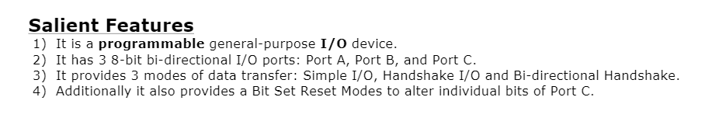
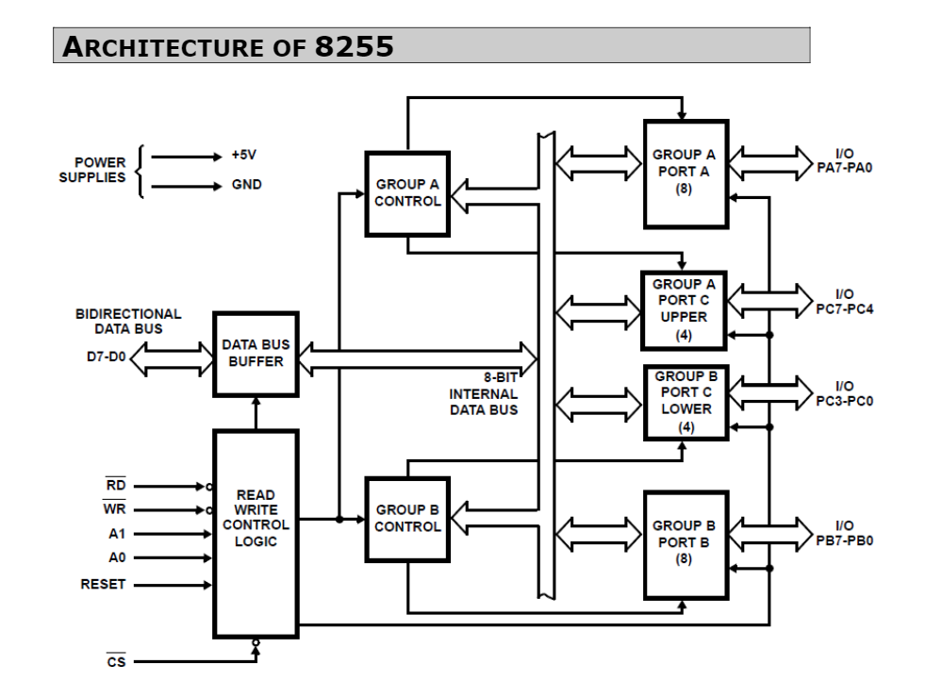

Slide 6
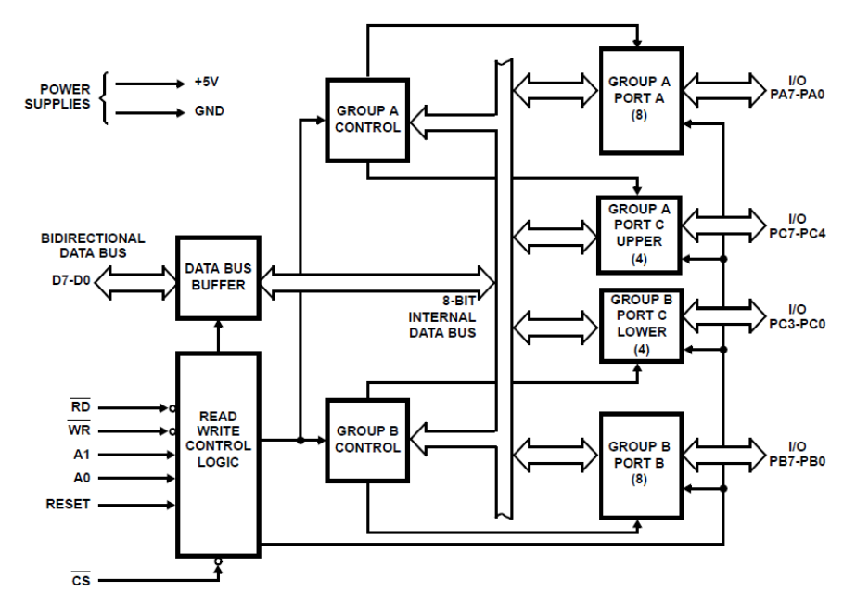
8255 is connected between processor and I/O devices.
One part of architecture is connected with 8086 and another part is connected with I/O devices through ports.
Printer
8255 is having 3 ports : Port A, Port B, Port C ( 8 –bits) each.
Port C is divided into 2 parts i.e. Port C Upper and Port C Lower.
Physically it is single port but logically it is divided into 2 parts.
Speaker
Example :
Following devices are connected with 8255 through ports : Printer, Monitor, Speakers.
Suppose 8086 wants to send data to printer, processor wants to print something.
Monitor
In this case that data will transfer to respective port only i.e Port A ( Not to all Ports)
There fore every port has it’s unique address.
3 – unique addresses for 3 – ports and 1- CWR i.e. Control Word Register
CWR
It is used to give commands to the 8255 ( I/O and BSR )
It is used to program the 8255 chip

Slide 7
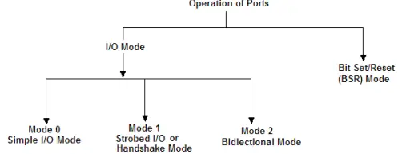
Modes of operation

Slide 8
8255A has three different operating modes −
Mode 0 − In this mode, Port A and B is used as two 8-bit ports and Port C as two 4-bit ports. Each port can be programmed in either input mode or output mode where outputs are latched and inputs are not latched. Ports do not have interrupt capability.
Mode 1 − In this mode, Port A and B is used as 8-bit I/O ports. They can be configured as either input or output ports. Each port uses three lines from port C as handshake signals. Inputs and outputs are latched.
Mode 2 − In this mode, Port A can be configured as the bidirectional port and Port B either in Mode 0 or Mode 1. Port A uses five signals from Port C as handshake signals for data transfer. The remaining three signals from Port C can be used either as simple I/O or as handshake for port B.

Slide 9
Addressing of 8255 PPI
8255 PPI
Data bus
For 8086
PA
Port | A7 | A6 | A5 | A4 | A3 | A2 | A1 | A0 | Add
PA | 1 | 0 | 0 | 0 | 0 | 0 | 0 | 0 | 80H
PB | 1 | 0 | 0 | 0 | 0 | 0 | 1 | 0 | 82H
PC | 1 | 0 | 0 | 0 | 0 | 1 | 0 | 0 | 84H
CWR | 1 | 0 | 0 | 0 | 0 | 1 | 1 | 0 | 86H
VCC
For 8086
A2
A1
A1
A0
8255
PB
G1
74138
3:8
decoder
Y0
A7
A6
A5
C
Y1
CWR
1
Y2
PC
B
Y3
CS
0
Y4
Y5
A
Y6
0
Y7
A0
G2A
G2B
For 8255
A4 A3
A0 | A1 | Port
0 | 0 | Port A
0 | 1 | Port B
1 | 0 | Port C
1 | 1 | CWR

Slide 10
Why Port C is divided into two parts????
For reliable transfer 8255 is used which provides handshake signals like permission and acknowledgement and etc.
8255 works in three modes : Mode 0 , Mode 1, Mode 2
When 8255 is in Mode 0 i.e. simple mode all three ports are used to transfer the data without handshaking.
 | M0 Simple | M1 Handshake I/O | M2 Bi-directional handshake
PA
PB
PC
When 8255 is in Mode 1 i.e. Handshake I/O mode, data transfer is done with handshaking signals. Hence only PA and PB is used for data transfer. Port C is used to perform handshaking.
Yes
Yes
Yes
There 4 signals are required to perform handshaking so Upper Port C is used for Port A and Lower Port C is used for Port B.
Yes
Yes
No
Yes
Handshake
Handshake
For above port can be either Input or Output
When 8255 is in Mode 2 i.e. bidirectional handshaking, (port can be at a time input and output) only Port A is used. Port B not used in M2. Port C is used for handshaking.

Slide 11
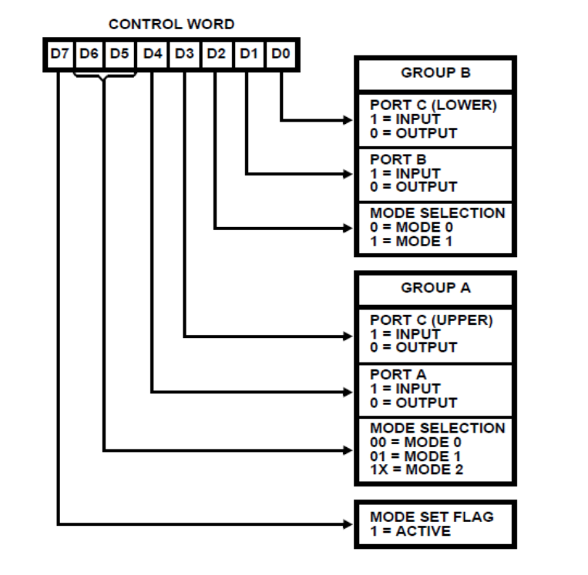
Examples:
Write a program to transfer 25H to an o/p device which is connected with Port A. Port B and Port C both are i/p ports. All three ports are in mode 0. Assume port addresses as follows: PA = 13H, PB = 14H, PC= 15H, CWR = 16H
D7 | D6 | D5 | D4 | D3 | D2 | D1 | D0
1 | 0 | 0 | 1 | 1 | 0 | 1 | 0
=
9A
MOV AL, 9AH
OUT 16H, AL
MOV AL, 25H
OUT 13 H ,AL

Slide 12
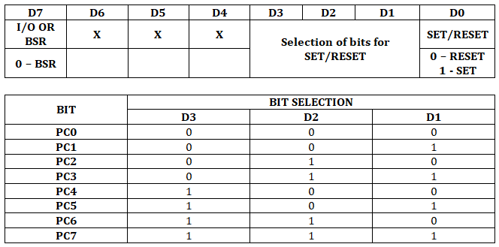
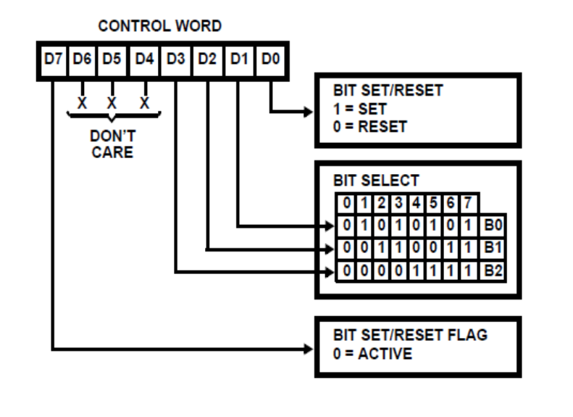
BSR Mode (BSR Command) is only applicable for Port C. In this Mode the individual bits of Port C can be set or reset. This is very useful as it provides 8 individually controllable lines which can be used while interfacing with devices like an A to D Converter or a 7-segment display etc.
The individual bit is selected and Set/reset through the control word. Since the D7 bit of the Control Word is 0, the BSR operation will not affect the I/O operations of 8255.

Slide 13
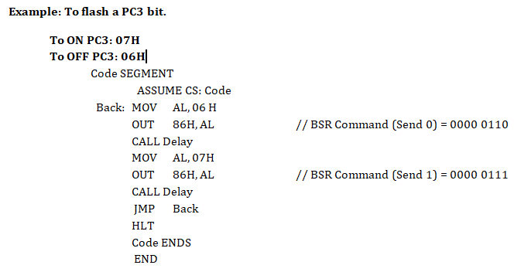

Slide 14
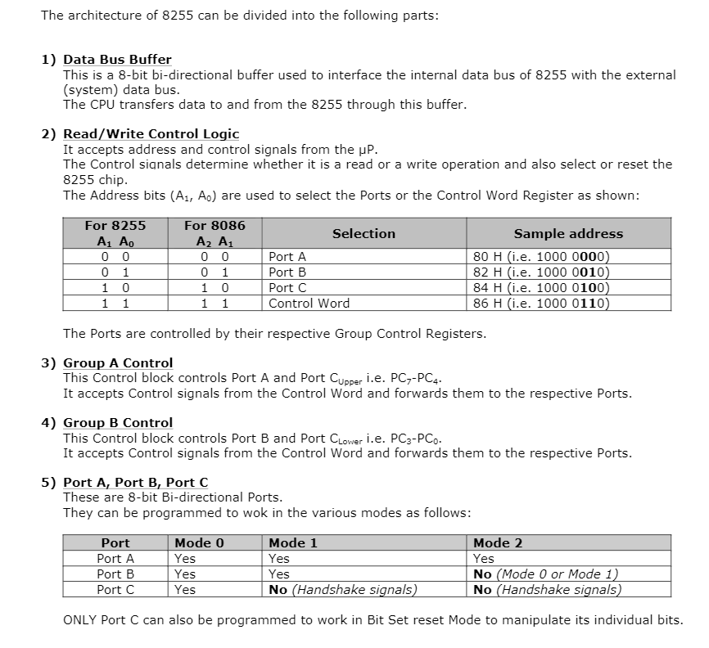

Slide 15
8255 modes :
1. M0 Simple
Port A , Port B, Port C : I/O
No Handshaking
2. M1 Handshake I/O
Port A , Port B : I/O
Handshaking with Port C
3. M2 Bi-directional handshake
Handshaking with Port C
Port A : I/O

Slide 16
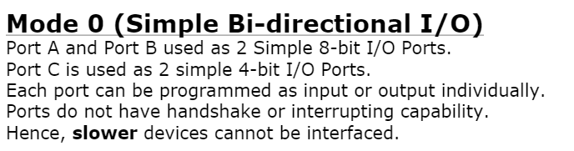
1. M0 Simple
Port A , Port B, Port C : I/O
No Handshaking

Slide 17
Operating Mode 0 [ Simple Mode ]
It is a normal mode of data transfer.
All 3 ports are available for data transfer. Port A, B will be used as 2 8-bit ports and Port C is used as 2 4-bit ports.
It is less reliable because of no handshaking.
Here slower devices cannot be interfaced easily

Slide 18
Mode 1 [ Input Handshaking ]
Mode 1 is unidirectional handshaking, which means either handshaking can be done for input devices or output devices only.
In traditional CPUs, there were separate ports only for keyboard, mouse….. Which means the keyboard port could be only used for keyboard only.
In present day computers, USB ( universal serial bus ) is used, which is bidirectional handshaking. Here there are 4 signal pins, but in architecture we have seen RD pin is already attached to the control pin.
So we need 3 pins from Port C for handshaking. This was second operating modes of 8255 PPI.

Slide 19
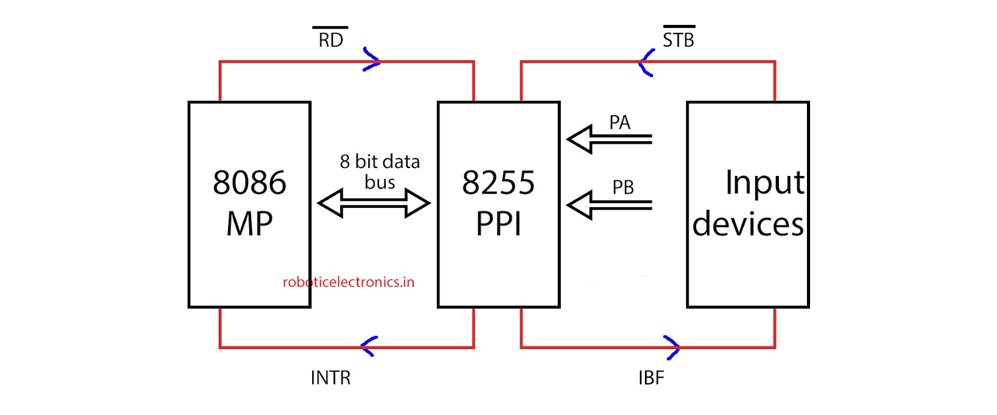

Slide 20
Input device gives STB signal ( active low ) to 8255 before sending data. If 8255 already has some data, then it doesn’t allow the Input device to send data.
8255 accepts data and stores it in the input buffer register. As soon as it receives the data, it gives an IBF signal ( input buffer is full ) . If IBF = 1, it does not allow any other data to enter 8255 PPI.
Now 8255 has data that should be sent to 8086. It makes INTR high, which means it is interrupting the processor.
Whenever the processor is free, it services this INTR. Then the Processor sends an RD ( active low ) signal and makes data transfer via data bus.
As soon as the RD signal is given , INTR gets low.

Slide 21
Complete stepwise handshaking :
STB ( active low ) goes low.
IBF goes high. ( IBF = 1, it does not allow any other data to enter 8255 PPI.)
INTR goes high.
RD ( active low ) goes low.
INTR goes low.
RD ( active low ) goes high.
IBF goes low.(Input buffer full)

Slide 22
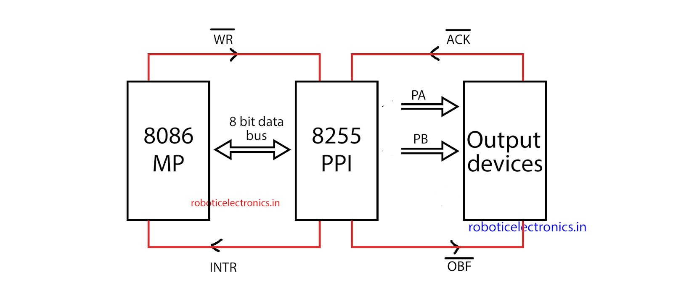
Mode – 1 [ Output Handshaking ]

Slide 23
In this type, 8255 will be accepting data from 8086 processor. It is vice versa to input handshaking. Here there are 4 signal pins, but in architecture we have seen WR pin is already attached to the control pin. So we need 3 pins from Port C for Handshaking
Complete stepwise handshaking
WR signal is activated.
INTR is set to low. [ now 8086 cannot send data again ]
OBF goes low [ Output buffer is full ]
ACK goes low ( it is active low signal )
OBF goes back to high
ACK goes back to high
Data transfer is successful, so INTR goes back to high.

Slide 24
Mode 2 [ Bidirectional Handshaking ]
In this mode, two way handshaking can be done. For normal input handshaking we require 3 pins for handshaking, similarly 3 pins for output handshaking. For bidirectional handshaking we need 5 pins ( because one INTR is enough )
If PA is in mode 2, which means it is utilizing ⅝ pins of port C for handshaking. So there are 3 remaining pins of port C, so definitely port B cannot be operated in mode-2, but while port-A is in mode-2, port-B can be operated in Mode – 0 or mode – 1.

Slide 25
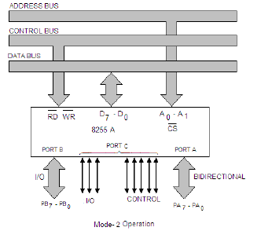

Slide 26
2. M1 Handshake I/O
- When any input device wants to send data to processor, it will first send data to 8255. Then 8255 will send that data to processor.
Port A , Port B : I/O
Handshaking with Port C
1. Mode 1 - I/P
- When any connected input device wants to send data to 8255, first it has to take permission from 8255. Device has to inform to 8255 about the transfer otherwise 8255 will receive the garbage value.
RD
STB
- I/P device first send STB bar signal ( Strobe) to 8255 along with the data. This s/g is to wake up the 8255.
PC s/g
8086
8255 PPI
I/P device
- 8255 will receive the data which is stored into it’s internal register.
3
Data bus
- After receiving and storing data into it’s internal register 8255 will generate IBF s/g to input device. (Input Buffer Full).
- If I/P device wants to send another data then I/P device will check the status of IBF s/g. If IBF = 1 means still first data is not proceed. So device has to wait.
- 8255 wants to send the data to the processor, it will not directly send the data. It will first send INTR s/g i.e. interrupt to processor.
PC s/g
PC s/g
- When processor will free, it will start reading the data from 8255 by making RD bar low.
INTR
IBF
- 8255 will make INTR low as soon as it will receive RD bar from 8086
When 8086 completes its reading it will make RD bar high
After receiving RD bar high, 8255 will make IBF low.
This can be Port A or Port B

Slide 27
2. M1 Handshake I/O
- When processor wants to send data to any output device, it will first send data to 8255. Then 8255 will send that data to O/P device.
Port A , Port B : I/O
Handshaking with Port C
- When 8086 wants to send data to 8255, first it has to check whether the 8255 is free or not.
1. Mode 1 - O/P
- Instead of performing polling (continuously keep checking) by 8086, 8255 will inform by itself to 8086 whether it has free or not.
WR
ACK
- If 8255 is free by default INTR is 1 ( by default INTR is high means 8255 keep interrupting to 8086, it’s depend upon the processor whether to and when to entertain the interrupt
PC s/g
8086
8255 PPI
O/P device
3
- When 8086 wants to send data to an O/P device it will send data to 8255 by making WR bar = 0
Data bus
- After receiving WR bar = 0, 8255 will immediately make INTR = 0, otherwise 8086 will keep sending the data to 8255 and 8255 will loss the previous data.
- 8255 will put the data on port and make OBF bar = 0
PC s/g
- Device will give the acknowledgment to 8255 by sending ACK bar = 0
PC s/g
- Once the data received by device and ack bar =0 , 8255 will make OBF bar = 1.
INTR
OBF
- 8255 will make INTR = 1 as soon as data is received by device
This can be Port A or Port B

Slide 28
8 LEDs are connected with port A of 8255 and 8 switches are connected with port B. Write a program to send alternate ON-OFF pattern for connected LED's and receiving all ones from connected switches. Assume and mention addresses for 8255.
8255 PPI
Addressing of 8255 PPI
Data bus
For 8086
PA
Port | A7 | A6 | A5 | A4 | A3 | A2 | A1 | A0 | Add
PA | 1 | 0 | 0 | 0 | 0 | 0 | 0 | 0 | 80H
PB | 1 | 0 | 0 | 0 | 0 | 0 | 1 | 0 | 82H
PC | 1 | 0 | 0 | 0 | 0 | 1 | 0 | 0 | 84H
CWR | 1 | 0 | 0 | 0 | 0 | 1 | 1 | 0 | 86H
VCC
For 8086
A2
A1
A1
A0
8255
PB
G1
74138
3:8
decoder
Y0
A7
A6
A5
C
Y1
CWR
1
Y2
PC
B
Y3
CS
0
Y4
For 8255
Y5
A
Y6
A0 | A1 | Port
0 | 0 | Port A
0 | 1 | Port B
1 | 0 | Port C
1 | 1 | CWR
0
Y7
A0
G2A
G2B
A4 A3

Slide 29
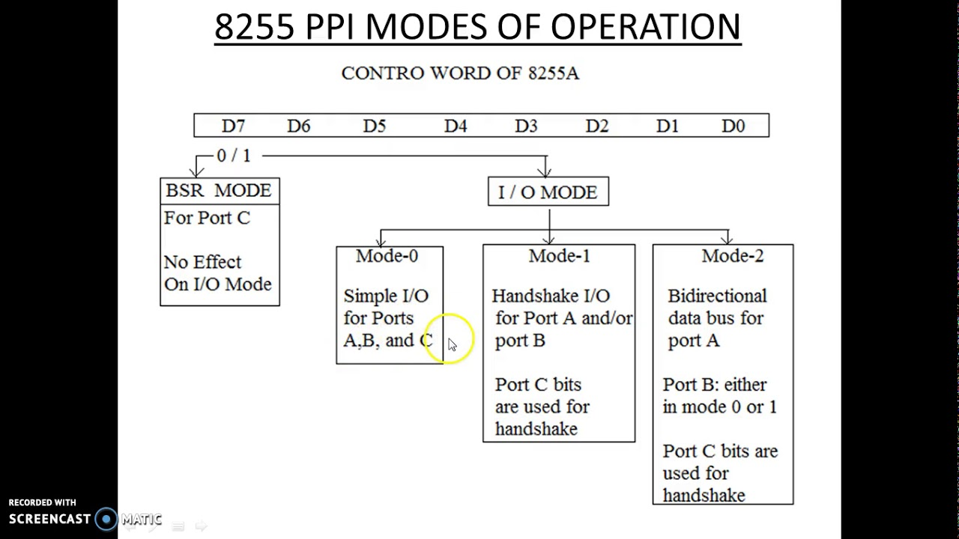

Slide 30
D7 | D6 | D5 | D4 | D3 | D2 | D1 | D0
1 | 0 | 0 | 0 | 0 | 0 | 1 | 0
=
82
D0
1
0
1
0
1
0
1
0
MOV AL, 82H
OUT 86H, AL
MOV AL, AAH
OUT 80 H ,AL
Mov al, FFH
IN Al, 82 H
D1
D2
D3
Port A
D4
D5
D6
D7
For 8 LEDs
1 | 0 | 1 | 0 | 1 | 0 | 1 | 0
=
AA

Slide 31
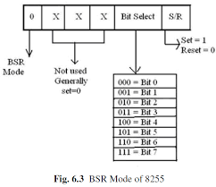
BSR MODE

Slide 32
The common applications of 8255 are:
Traffic light control
Generating square wave
Interfacing with DC motors and stepper motors

Slide 33
D0
a
a
Seven Segment Display
Cathode = 0
Anode = 1
D1
b
D2
c
f
b
D3
d
g
Port B
D4
e
f
e
c
D5
D6
g
d
. (dp)
D7
dp
dp
g
f
e
d
c
b
a
MOV AL, 92H
OUT 86H, AL
MOV AL, 06H
OUT 80 H ,AL
0
0
0
0
0
1
1
0
=
06
1’
1
0
0
1
0
0
1
0

Slide 34
Addressing of 8255 PPI
8255 PPI
Data bus
For 8086
PA
Port | A7 | A6 | A5 | A4 | A3 | A2 | A1 | A0 | Add
PA | 0 | 1 | 0 | 0 | 0 | 0 | 0 | 0 | 80H
PB | 0 | 1 | 0 | 0 | 0 | 0 | 1 | 0 | 82H
PC | 0 | 1 | 0 | 0 | 0 | 1 | 0 | 0 | 84H
CWR | 0 | 1 | 0 | 0 | 0 | 1 | 1 | 0 | 86H
VCC
For 8086
A2
A1
A1
A0
8255
PB
G1
74138
3:8
decoder
Y0
A7
A6
A5
C
Y1
CWR
0
Y2
PC
B
Y3
CS
1
Y4
Y5
A
Y6
0
Y7
A0
G2A
G2B
For 8255
A4 A3
A0 | A1 | Port
0 | 0 | Port A
0 | 1 | Port B
1 | 0 | Port C
1 | 1 | CWR

